Slide 1
pitch PRESENTATIon
GC LAMP(Learners’ Academic Management Portal)

Slide 2
GC LAMP
Learners’ Academic Management Portal

Slide 3


LMS (Learning Management System)
LMS - is a software application for the administration, documentation, tracking, reporting, automation, learning and development programs.

Slide 4



The GC LAMP Team
LOUDEL MANALOTO
OWEN JASPER VARGAS
RIEJAN EGUITA
BS Computer Science
Team Leader
BS Computer Science
Web App Hacker
BS Information Technology
Web App Hacker

Slide 5

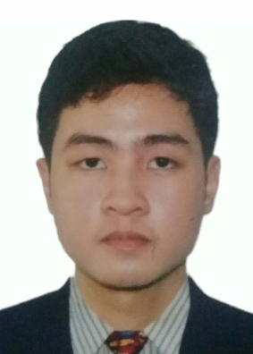
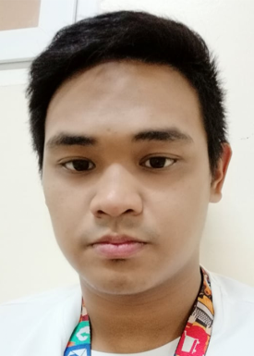
The GC LAMP Team
ORLIE JOHN RUSSEL LABRADOR
JAYE LABANDIA
REGIN LOUISE TOLENTINO
BS Computer Science
Hipster
BS Information Technology
Hipster
BS Information Technology
Mobile App Hacker

Slide 6
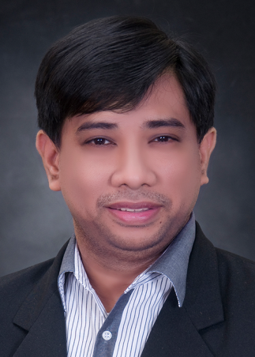
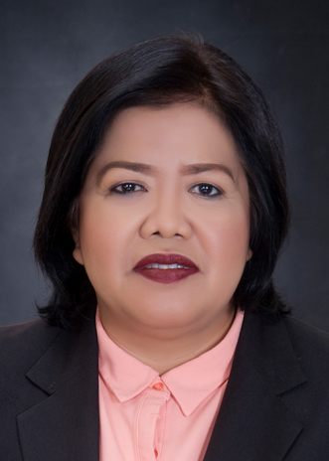
The GC LAMP Team
MELNER BALCE
ERLINDA C. ABARINTOS, DIT, FRIIT
Team Technical Adviser
GC Web Admin/CCS Instructor
Team Adviser/Project Manager
VP for Admin and Finance/CCS Dean

Slide 7



Problems
Gordon College does not have an online platform that will address the need of the students for continuous learning
Subscription to commercial Learning Management Systems cost a lot
Most of the LMS does not fit the needs of the institution

Slide 8
Solution
Develop an in-house learning management system that is cost effective and fits the need of the institution

Slide 9


Slide 10





Development Stage: Technologies

Slide 11

Customer

Slide 12

Revenue Stream

Slide 13
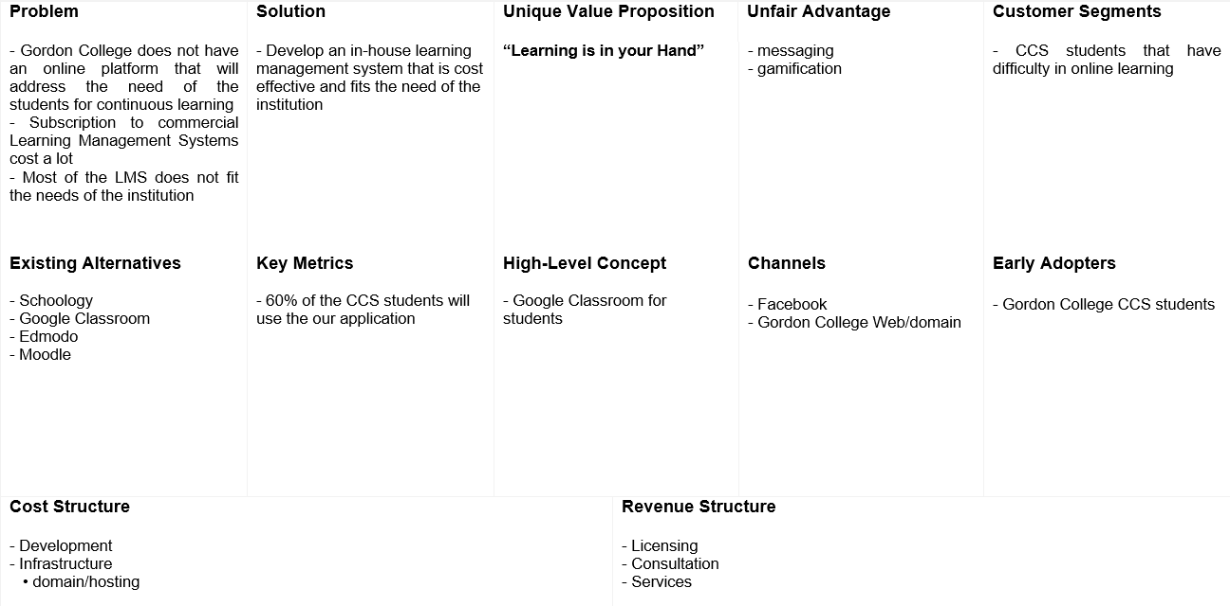
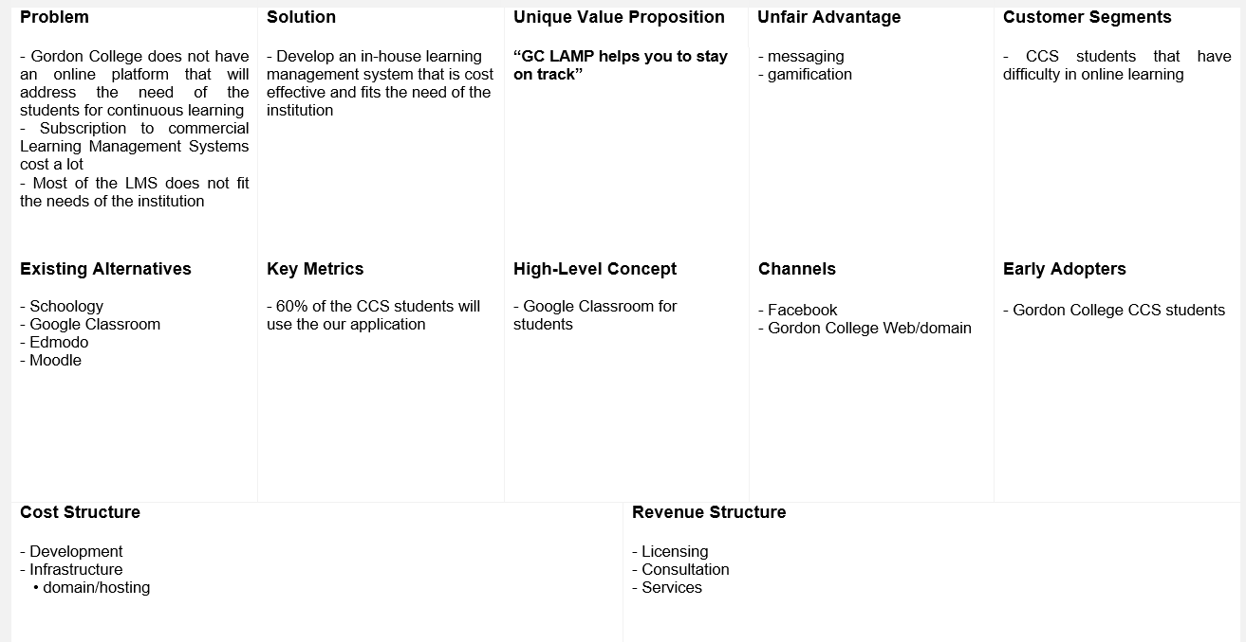
Lean Canvas

Slide 14
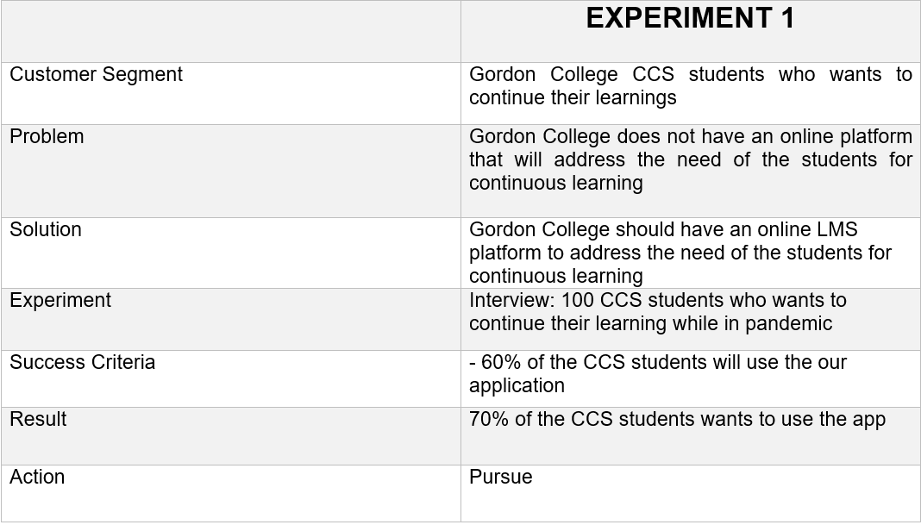
Simplified Validation Board

Slide 15
THE END!
Thank you for your attention and have a nice a day to you all.

